Slide 1
E-Commerce Business Management System
🪡
ShajBari
Project
Presentation
FASHION HOUSE
Full-Stack Web Application
Saree & Panjabi E-Commerce Platform
HTML5
CSS3
JavaScript
PHP
MySQL
Course: CSE 232 – Database System Design (Lab)
Primeasia University
Submission: 13/05/2026
Submitted by:
Md. Jobaidul Islam (242-008-042)
Asib Hossen (242-011-042)
Ziaur Rahman Arnab (242-045-042)

Slide 2
Project Overview
What is ShajBari?
📄
⚙️
ShajBari is a Bangladeshi online fashion store for Saree and Panjabi clothing. Customers can browse products, filter by category, add items to a cart, and place Cash on Delivery orders.
Logged-in users get a personal profile page to view all their past orders with a visual status tracker.
4
9
HTML Pages
PHP file
🗄️
📱
4
100%
DB Tables
Responsive
Target Market: Bangladesh | Payment: Cash on Delivery | Language: English

Slide 3
Tech Stack & File Structure
🌐
HTML5
📁 Project Root
Page Structure
├── index.html
├── login.html
├── register.html
├── profile.html
├── 📁 css/
│ ├── style.css
│ ├── login.css
│ ├── register.css
│ └── profile.css
└── 📁 php/
├── db.php
├── login.php
├── register.php
├── order.php
└── ...
🎨
CSS3
Styling & Responsive Layout
⚡
JavaScript
Cart, Dynamic UI
🐘
PHP
Server Logic & Session
🗄️
MySQL
Database Storage

Slide 4
Database Design
🗂 users
🗂 orders
▸ id (PK)
▸ fullname
▸ email (UNIQUE)
▸ phone
▸ password (hashed)
▸ created_at
▸ id (PK)
▸ user_id (FK → users)
▸ order_number (UNIQUE)
▸ customer_name
▸ phone / address
▸ subtotal / delivery / total
▸ payment_method
▸ status (ENUM)
▸ created_at
🗂 order_items
🗂 contact_messages
▸ id (PK)
▸ order_id (FK → orders)
▸ product_id
▸ product_name
▸ price / quantity
▸ id (PK)
▸ name / email
▸ message
▸ is_read
▸ created_at
🔗 orders.user_id → users.id | order_items.order_id → orders.id (CASCADE DELETE)

Slide 5
How It All Connects
Complete User Auth Flow
➜ Register → password_hash() → INSERT users
➜ Login → SELECT user → password_verify() → $_SESSION set
➜ Page Load → check_session.php → JSON → navbar updated
➜ Logout → session_destroy() → redirect

Slide 6
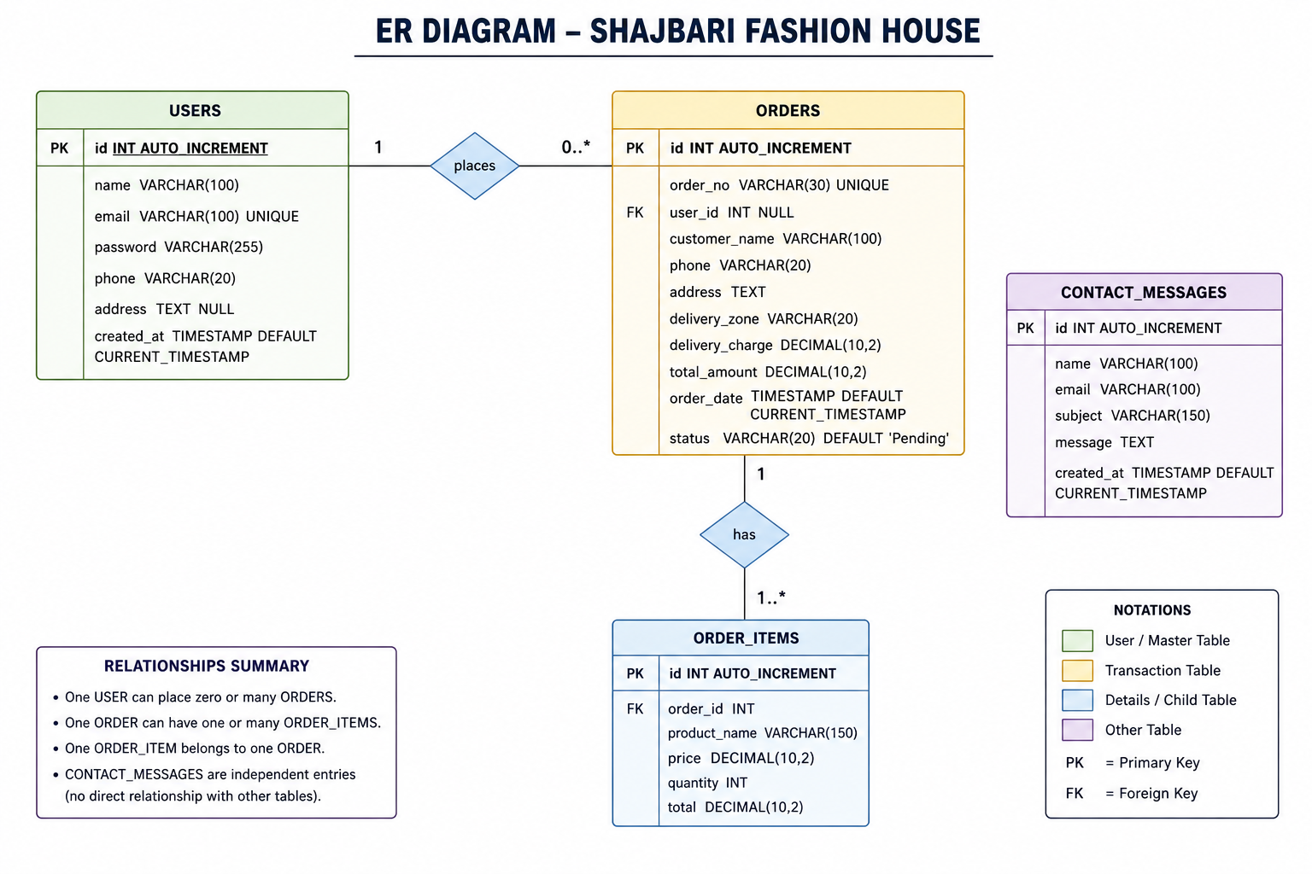

Slide 7
Frontend Features
🏠
🔍
🛒
Hero Section
Live Search
Cart Sidebar
Animated banner with stats: 500+ Products, 10K+ Customers, 4.9★ Rating
Filters product grid in real-time as user types — no page reload
Slide-in cart with add/remove, quantity control, and delivery zone selector
👤
📦
📱
Session Navbar
Order System
Responsive Design
Checks login status via AJAX; shows user avatar + dropdown or Login button
Collects name, phone, address → sends JSON to PHP → shows confirmation modal
Mobile-first layout using CSS media queries; hamburger menu on small screens

Slide 8
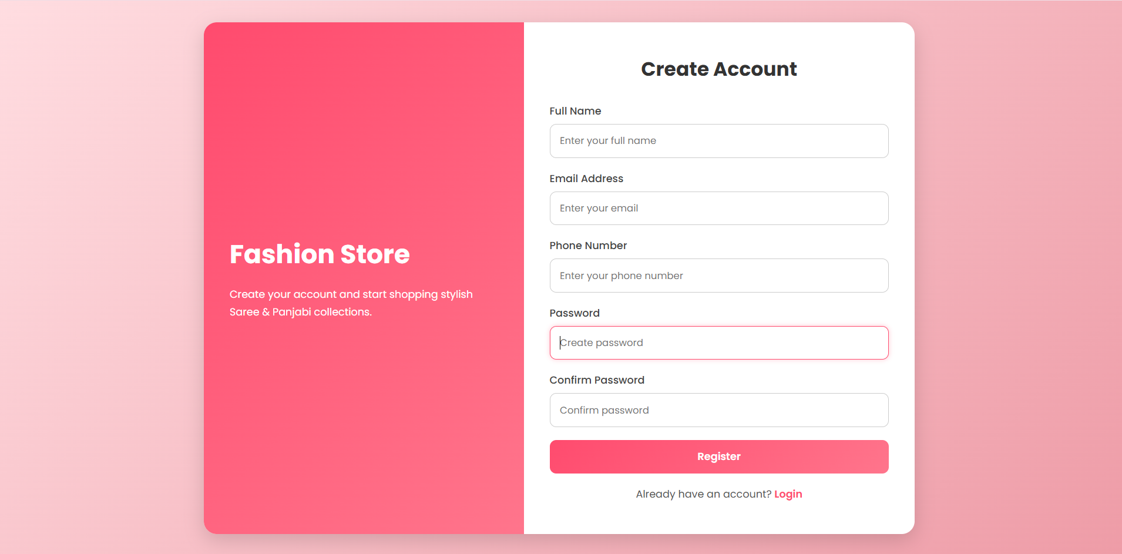
USER INTERFACE
Register Form

Slide 9
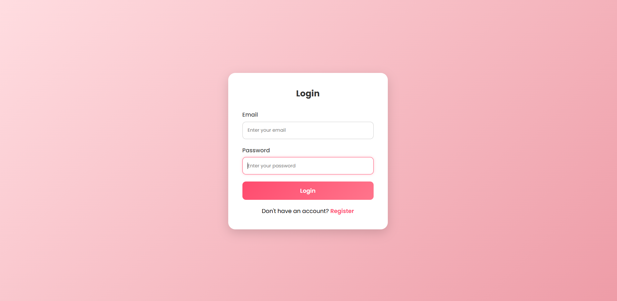
Login Form

Slide 10
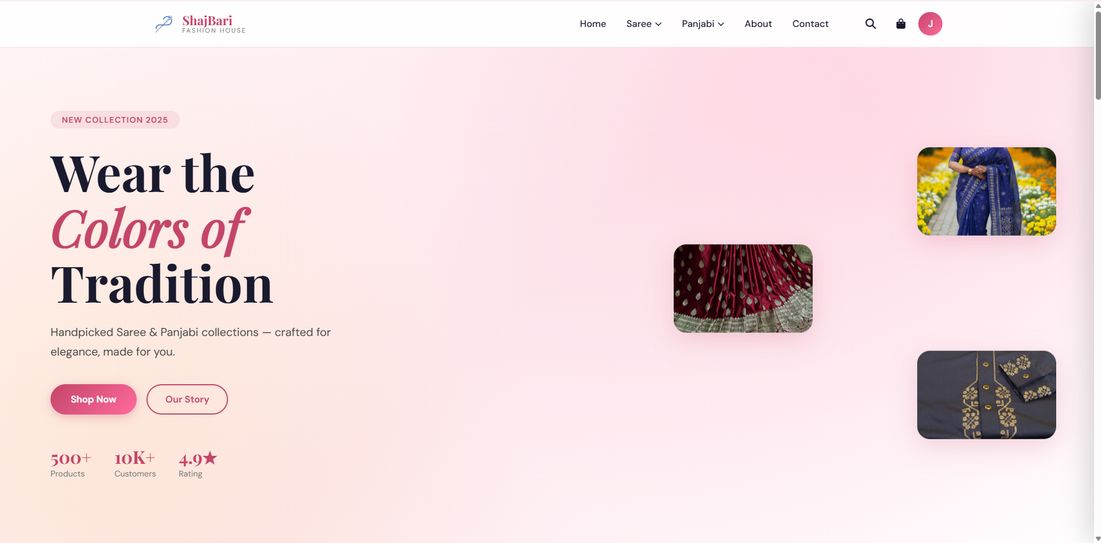
Home Page

Slide 11
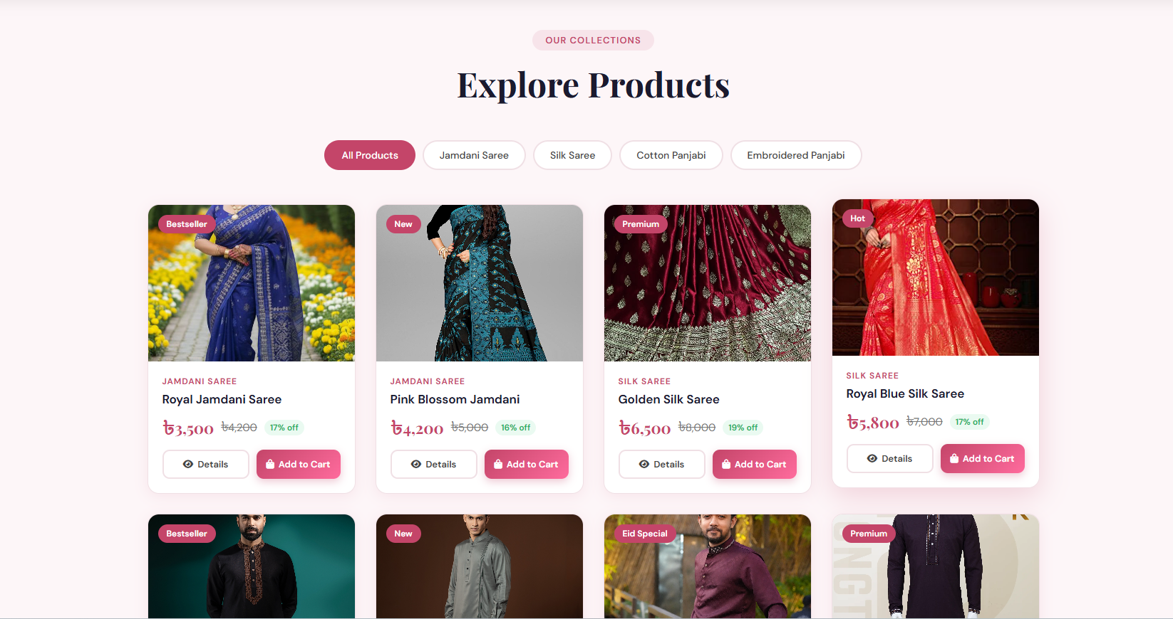
Product Cart

Slide 12
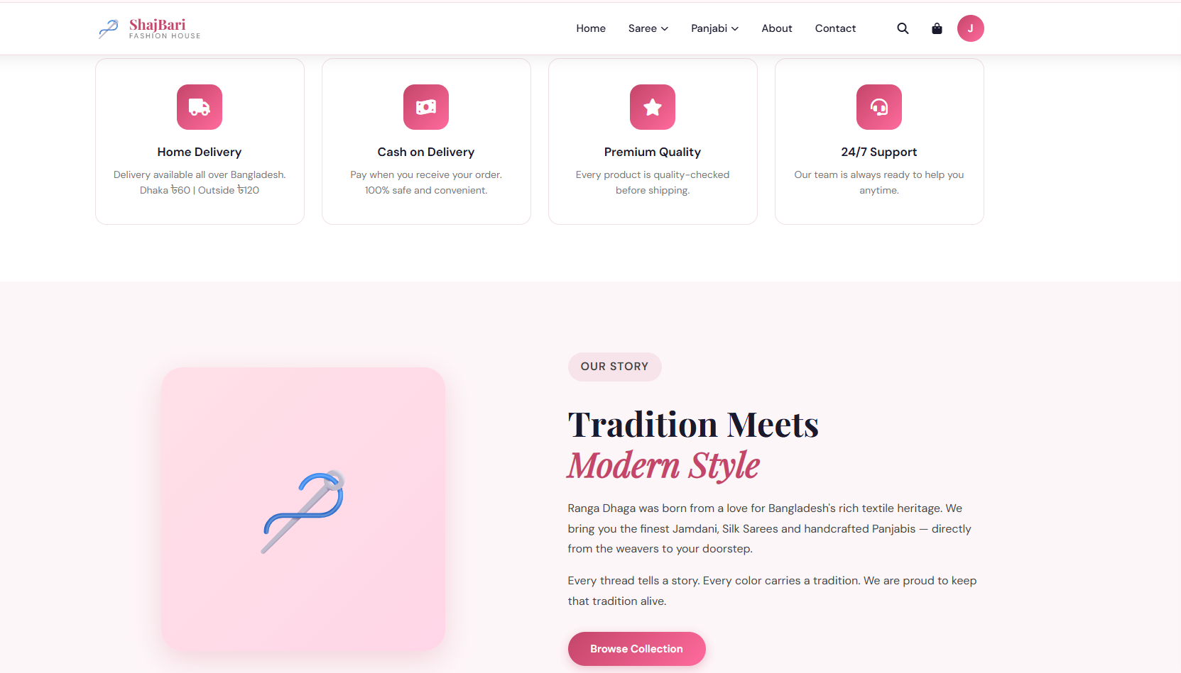
About Section

Slide 13
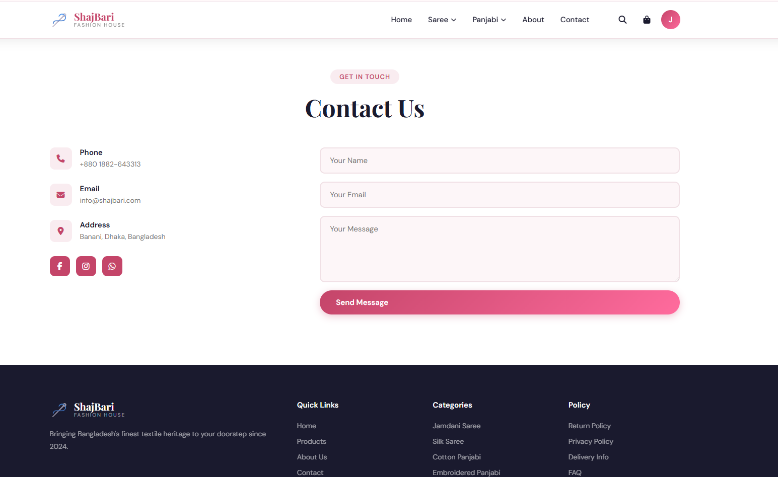
Contact Section

Slide 14
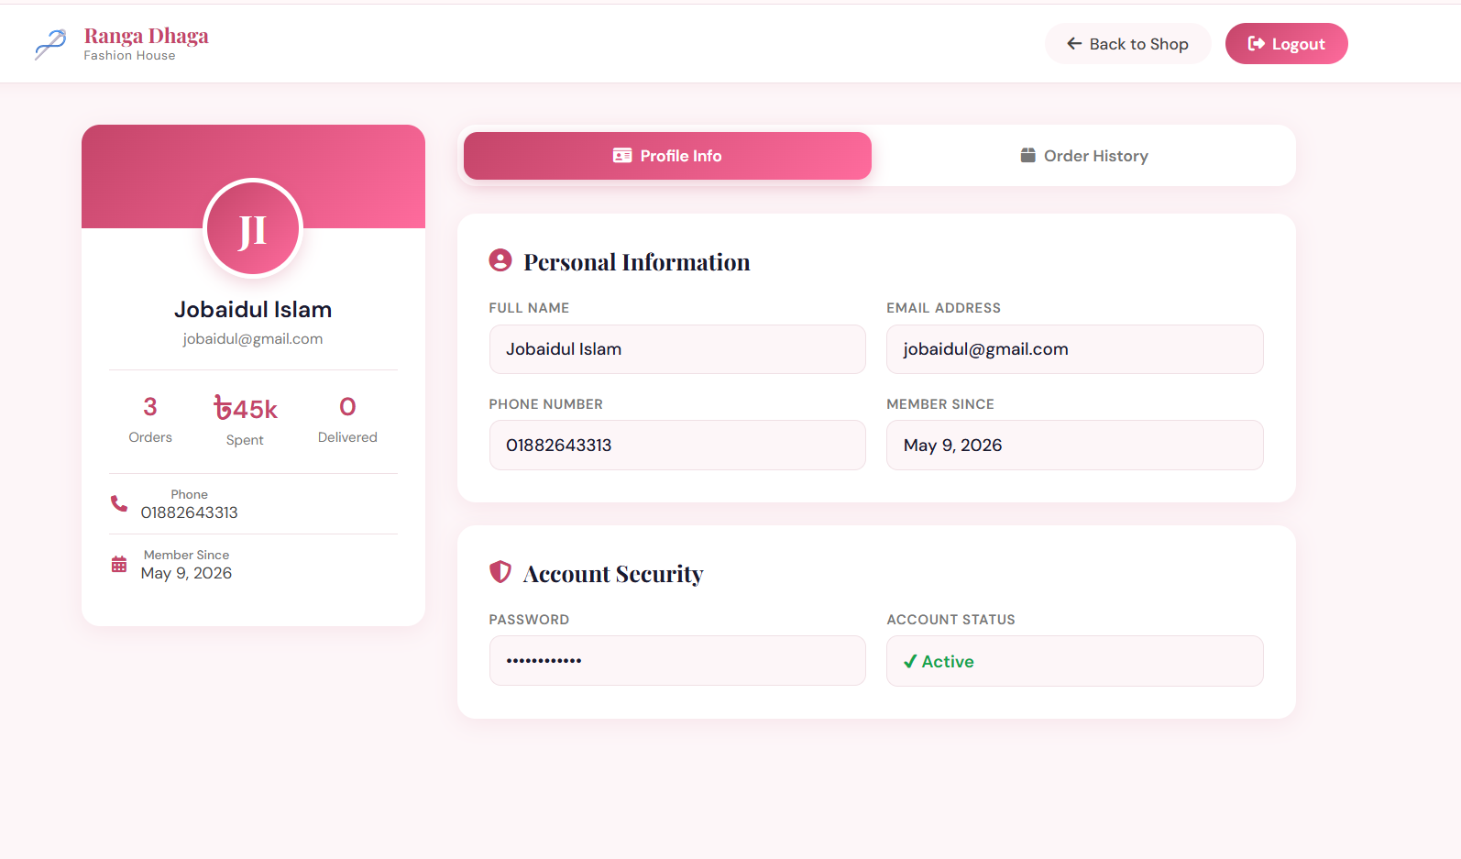
Profile Section

Slide 15
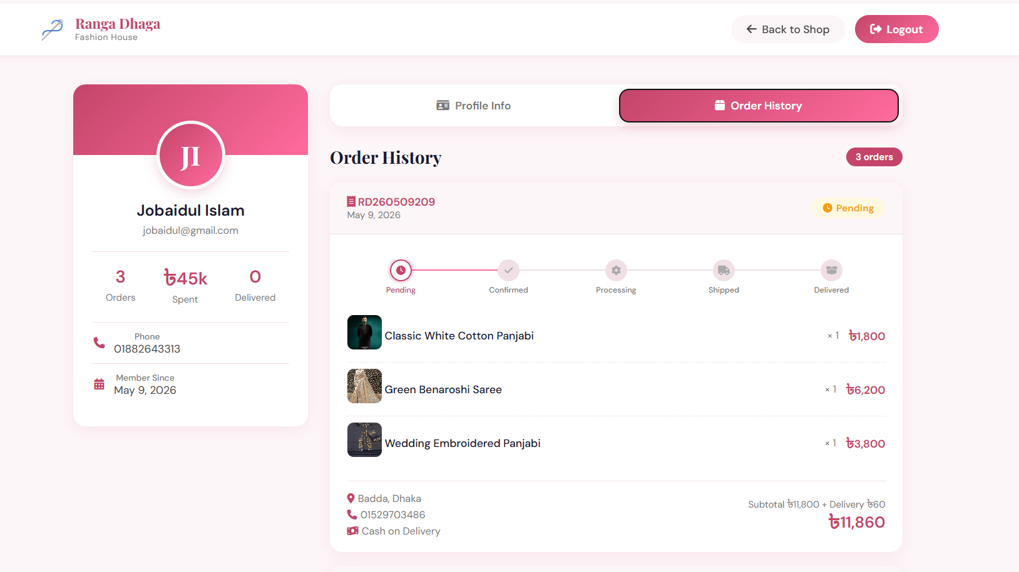
Order History

Slide 16
PHP Backend
PHP Files & Their Jobs
db.php
MySQL connection (shared by all files)
register.php
Validate form, hash password, INSERT user
login.php
Verify password, set $_SESSION variables
logout.php
Destroy session, redirect to homepage
check_session.php
Return JSON: is user logged in?
get_profile.php
Return JSON: user name, email, phone
get_orders.php
Return JSON: orders + nested items
order.php
Receive JSON cart, INSERT order + items
contact.php
Validate & INSERT contact message

Slide 17
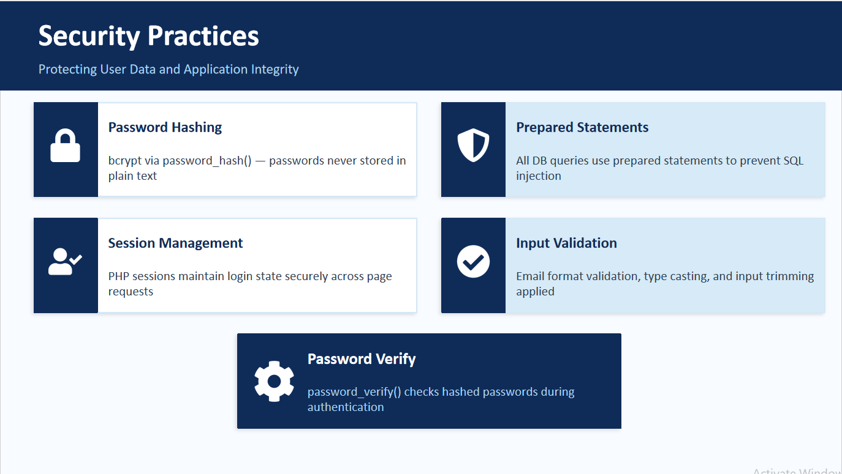

Slide 18
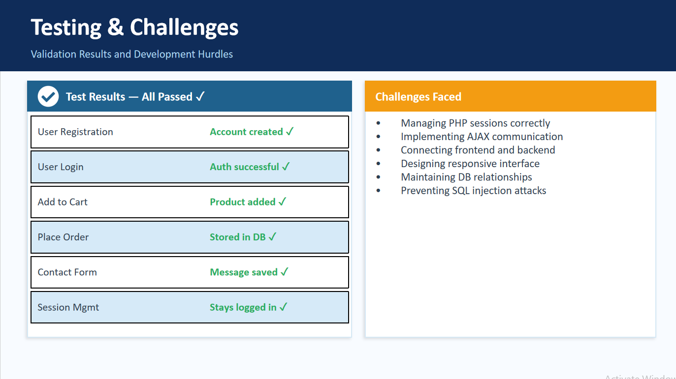

Slide 19
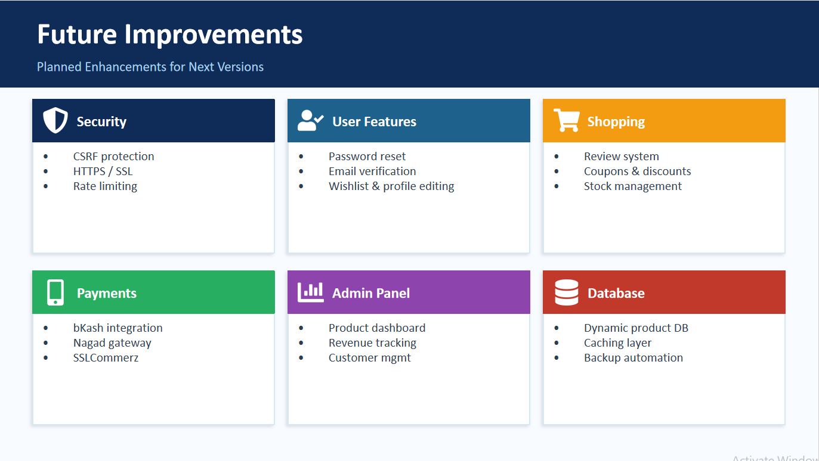

Slide 20
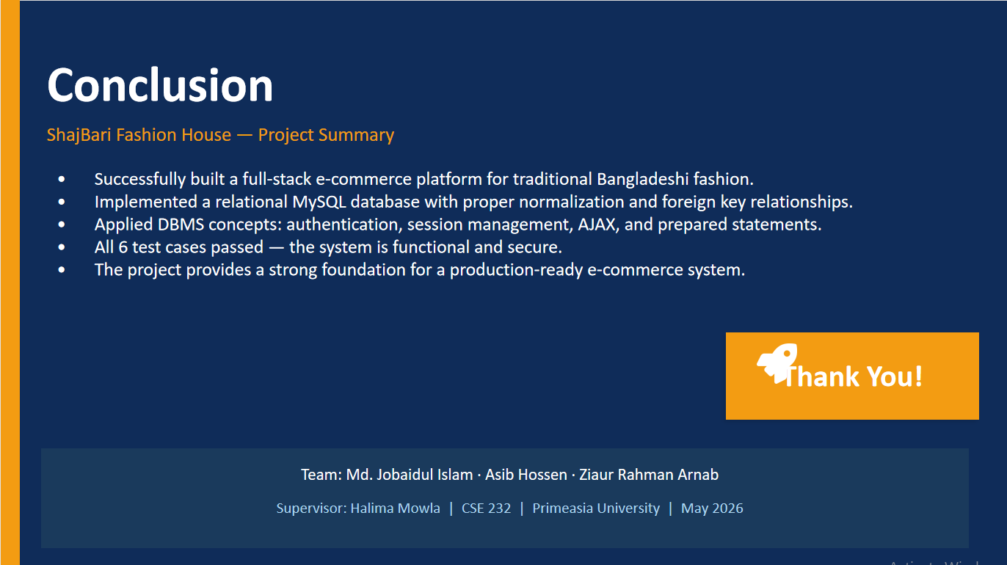

Slide 21
🪡
Thank You!
ShajBari Fashion House — Full-Stack Web Project
4
9
4
100%
Pages
PHP Files
DB Tables
Secure Auth
Built with HTML · CSS · JavaScript · PHP · MySQL
Questions? 🙋

